Slide 1
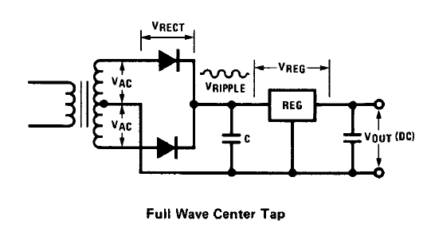
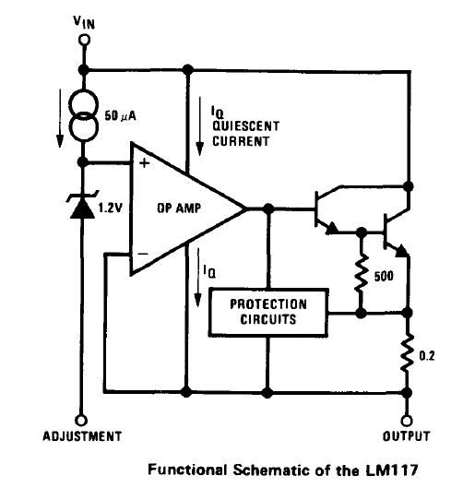
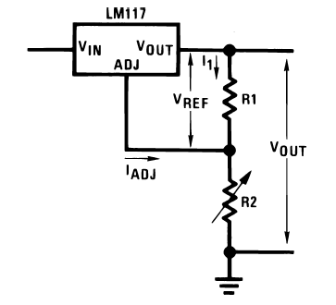
















$$=10 mA$$
$$I_{Lmax}=2.2 A$$
$$V_{IN}$$
$$50 μA$$
$$v_{+}$$
+
$$1.2 V$$
-
$$v_{−}$$
$$500 Ω$$
$$V_{ref}=1.2V$$
$$0.2 Ω$$
$$I_{ADJ}=50 μA$$
$$V_{Out}$$
$$R_{1}$$
$$V_{out}=1.2\left(1+\frac{R_{2}}{R_{1}}\right)+50 μAR_{2}$$
$$Adjustment$$
$$R_{2}$$

Slide 2
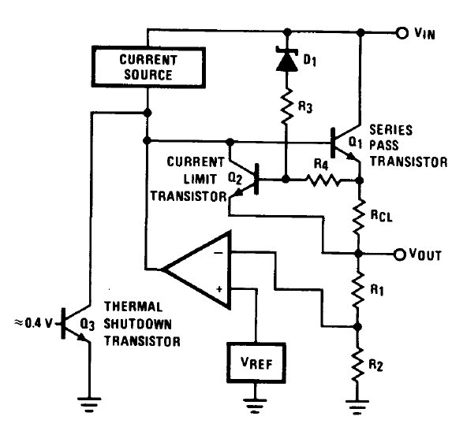
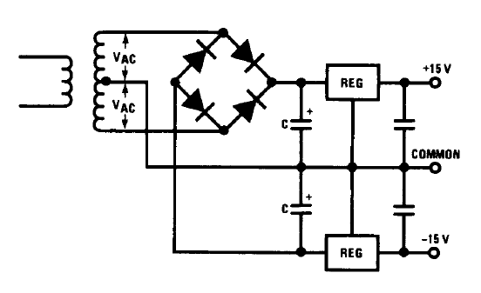
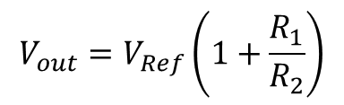
7805
7812
7815
7905
7912
7915
$$V_{out}=V_{Ref}\left(1+\frac{R_{1}}{R_{2}}\right)$$

